Slide 1
2015 Champion Awards
Illinois 60 by 25 Network
Leadership Communities

Slide 2
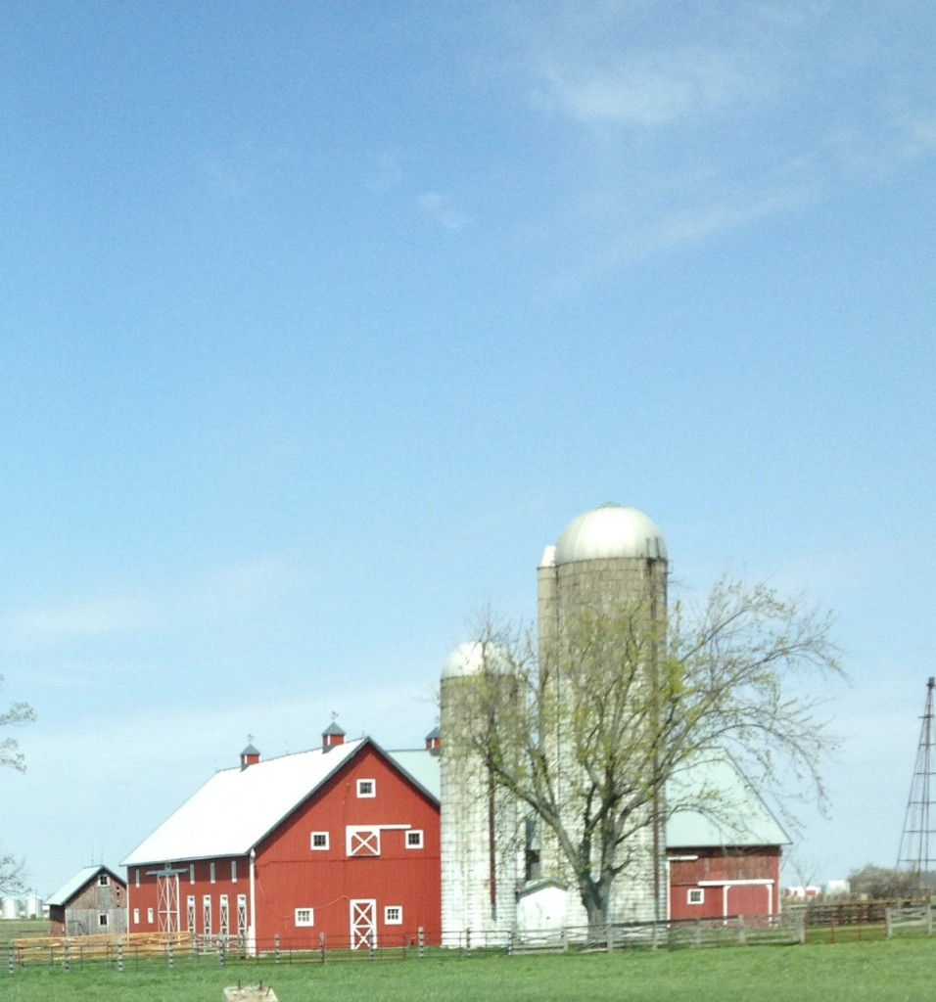

Slide 3
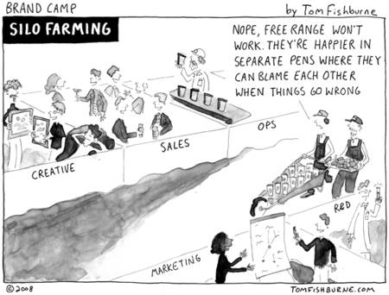

Slide 4
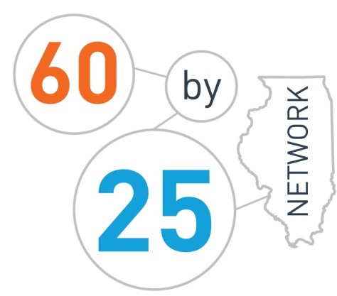
Supporting Illinois communities to create sustainable education-to-employment
systems for all students

Slide 5
The Illinois 60 by 2025 Network is an ever-emerging network of communities that are committed to the goal of ensuring that 60% of all adults have a college or career credential by 2025.
This network is designed to meet the needs of communities that are working together to provide rigorous, real world learning in and out of the classroom.

Slide 6
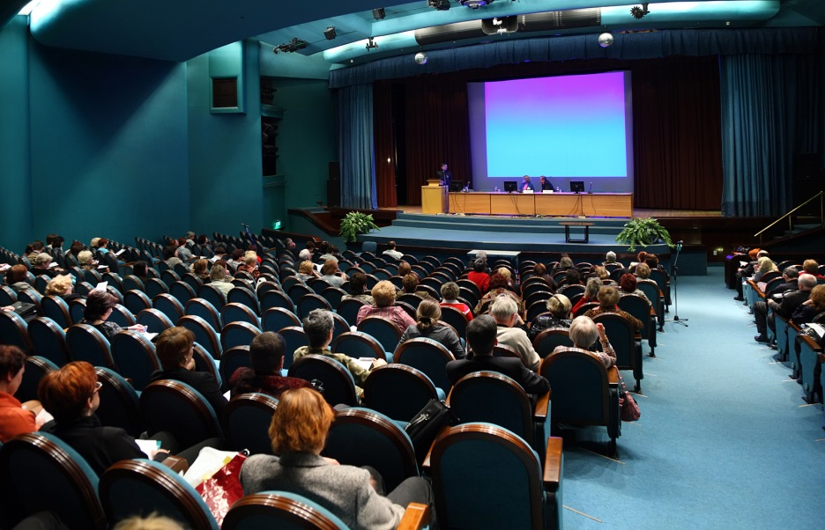
Bringing Communities Together
January 2014 Conference – East Peoria
January 2015 Conference – Aurora
January 2016 Conference – Springfield
January 26-27
Theme: Vision to Action

Slide 7
Leadership Communities
Documented partnership involving employers, education, municipal leadership, & community-based organizations
Defined community of focus
Prioritized STEM industry clusters for career pathway systems
Identified lead intermediary organization
Initial plan for major activities
Aurora Regional Pathways to Prosperity
East Side Aligned
Health Professions Education Consortium of Lake County
Northwest Educational Council for Student Success
Peoria Pathways to Prosperity

Slide 8
Aurora Regional Pathways to Prosperity
Community/Region of Focus: Municipal boundaries of the City of Aurora
Prioritized STEM Industry Clusters: Manufacturing, Health Sciences, IT
Key Successes to Date:
Expanded enrollments in pathways ­related courses to 10,000, representing a 25% increase over previous year
Identified 75 employers for engagement
Launched IT internships and secured commitments from major health providers for volunteer and on-site learning opportunities
Key Activities for Upcoming School Years:
Create sequencing for on­boarding employers who provide work-based learning activities
Define key metrics and “house” data collection responsibilities
Establish work-based learning coordinator in 4 school districts for HS, IT, and MFG pathways
Expand Pathways orientation to middle school

Slide 9
East Side Aligned
Community/Region of Focus: East St. Louis School District footprint
Prioritized STEM Industry Clusters: Health Sciences, Information Technology, Energy, Transportation, and Finance
Key Successes to Date:
Conducted a Pathways to Prosperity Asset Mapping
Secured funding and employer engagement for Career Cruising Inspire
All East St. Louis School District students (7­-12th grade) developed their individual learning plan for college and career pathways
Key Activities for Upcoming School Years:
Implement middle school Possible Futures and Possible Selves career exploration pilot program
Expand dual credit with SWIC and Kaskaskia College
Establish health science job shadowing program and paid internship experience for high school students with moderate to severe mental disabilities

Slide 10
Health Professions Education Consortium of Lake County
Community/Region of Focus: Lake County, with a peripheral focus on Cook and McHenry Counties
Prioritized STEM Industry Clusters: Health Sciences, Information Technology, and Manufacturing
Key Successes to Date:
Launch of North Chicago’s Healthcare Careers Pathways Academy
Preparing to launch North Chicago’s IT Careers Pathway Academy with DePaul
In Waukegan, formalized pathways commitments from key community partners
Key Activities for Upcoming School Years:
Establish advisory committees with education and industry leaders for pathways activities
Expand dual credit options for high school students in North Chicago and Waukegan
Establish a coach to lead work-based learning and career exploration efforts

Slide 11
Northwest Educational Council for Student Success (NECSS)
Community/Region of Focus: Harper College/EFE 70 regions
Prioritized STEM Industry Clusters: Advanced Manufacturing, Health Sciences, Information Technology
Key Successes to Date:
NECSS established as a secondary and postsecondary regional educational collaborative with governance structure for driving impact
Established 41 programs of study with over 700 industry partners
Implemented developmental math course in senior year of high school to reduce the need for remediation at the college level
Key Activities for Upcoming School Years:
Provide expansive internship opportunities aligned to student career interests
Develop a regional secondary/postsecondary data system and dashboard to present the data
Expand dual credit programs with partnering postsecondary institutions

Slide 12
Peoria Pathways to Prosperity
Community/Region of Focus: Geographic area of Peoria Public Schools
Prioritized STEM Industry Clusters: Health Sciences, Manufacturing, Information Technology, and Transportation/Distribution/Logistics
Key Successes to Date:
Formed one year ago with heavy support from community leaders
Conducted a Pathways to Prosperity Asset Mapping
Received grant and national recognition from American Federation of Teachers to increase career and technical education offerings
Key Activities for Upcoming School Years:
Aligning high school curriculum to Illinois Central College applied science programs and employer expectations
Creation of work-­based learning opportunities by local businesses through the Inspire platform
Implement the apprentice program Central Illinois Center of Excellence for Secure Software (CICESS), beginning in the fall of 2015

